Slide 1
Course 2
Testing, Inspection, Walkthrough

Slide 2
How to perform SQ CONTROL?
Testing
Inspections
Walkthroughs
Reviews

Slide 3
Testing
Process of gathering information by making observations and comparing them to expectations [Dale Emery]
Most used quality improvement activity

Slide 4
Testing
Black-box:
tests the functionality of an application
Tester cannot see the inner code
White-box:
tests internal structures of an application
Tester knows the inner code

Slide 5
Testing
Unit testing – execution of a complete class/ routine written by a single person, tested in isolation
Component testing – execution of a class/ package written by several persons, tested in isolation
Integration testing – combined execution of 2 or more classes/ components/ packages/ subsystems created by teams – continuous process
Regression testing – repetition of previously executed test cases
System testing – execution of the final configuration, including integration with other systems

Slide 6
Debugging
≈ testing?
When you find an error (execute test case) => 2-steps process:
Determine the location and category of error
Fix the error

Slide 7
Testing vs. Debugging
Testing | Debugging
starts with known conditions, uses predefined methods, and has predictable outcomes | starts from possibly unknown initial conditions and its end cannot be predicted
Performed by testing team | Performed by development team
Can be automated | -
Goal: find as many bugs as possible | Goal: find and remove a bug
Find bugs | Find cause of the bug

Slide 8
Testing tools
Automate testing process
Tool for generating test cases
Tool for performing testing: unit, integration, system

Slide 9
Testing Tools
xUnit
C#, Java, Python
Mercury
Selenium, Winrunner, QTP
Application Center Test (ACT) .NET
WebSphere IBM
Unit testing
Component testing
Regression testing

Slide 10
Testing Software Quality
Testing – important part of SQA
Testing cannot prove error free programs
One testing strategy (unit/ component/ integration) – finds ≤ 50% errors
Combination of testing strategies – finds ≤ 60% errors
=> only testing does not improve SQ
Myers classic test:
1 program – 15 errors
Average ≈5 /15
Best ≈ 9/15

Slide 11
Software Inspection
Reading or visually inspecting the code
best industry practice for detecting software defects early and learning about software artifacts
Include:
the structured review process,
standard of excellence product checklists,
defined roles of participants, and
the forms and reports
Improve reliability, availability and maintainability

Slide 12
Steps in Software Inspection
Systematic procedure – all life-cycle
Steps
System of checklists
Roles
Forms and reports
Planning,
Preparation,
Entry criteria
Conduct
Exit criteria
Reporting
Follow-up
Inspection Record
Inspection Reporting Form
Report Summary Form
Moderator
Producer
Reader
Reviewer
Recorder
Manager
Consumer
Notes:
Moderator directs the activities
Producer creates materials to be inspected
Recorder completes forms
Reviewer raise issues

Slide 13
Checklist
For: requirements, architecture, specification, design, code, test procedure
Contains: completeness, correctness, style, metrics, rules of constructions, multiple views
example

Slide 14
Inspection Reporting Form
Issue no. | Line/Page | Checklist | Defect Category | Defect Type | . . .

Slide 15
Report Summary Form
 | Major |  |  | Minor
Defect Type | Missing | Wrong | Extra | Missing | Wrong | Extra
Interface
Logic
I/O
…
Functiona-lity
Maintai-nability

Slide 16
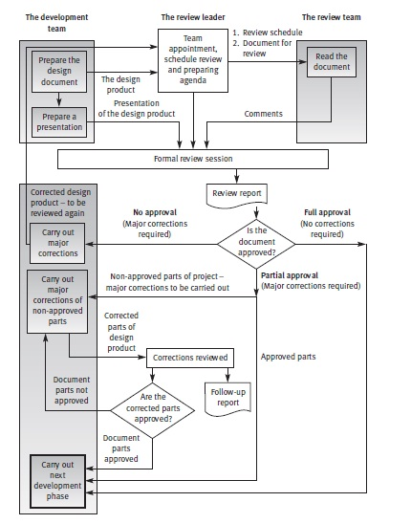
Review process diagram (from Galin-SQA)

Slide 17
SQA?
Inspections & walkthroughs – finds 30-70% of
logic design errors
coding errors
Inspection - IBM reported an 83% defect detection rate

Slide 18
Inspection vs. Walkthrough
formal review used to verify that the artifact complies with the standard of excellence
serve the needs of quality management in verifying that the software artifact complies with the standard of excellence
Used as an exit criterion
Uses a structured review process
Involves several roles
informal review used to confirm the understanding of the producer
serve the needs of the producer or author
may be several walkthroughs in each life-cycle activity.
yield open issues and action items

Slide 19

Inspection vs. Testing
Issues related to non-functional properties: Maintainability, evolvability, reusability
Properties difficult to test: Scalability, efficiency, security, integrity, robustness, reliability, exception handling
Artefacts: requirements, architecture, design documents (cannot “execute” as tests)

Slide 20
Inspection
Benefits:
Knowledge sharing
Find flaws early
Better communication: feedback
Drawbacks:
Why fix? Why wlakthrough code? / The reviewer will find it
Used for HR evaluation
Notes:
Knowledge sharing • Regarding designs and specific software artifacts • Regarding defect detection practices
Find flaws early • Can dramatically reduce cost of fixing them • During detail design – even before code is written • Or code that does not yet have a test harness • Or code in which testing has found flaws but root causes are not understood

Slide 21
Code review
Definition: an integral process of software development that helps identify bugs and defects before the testing phase
Human / automated
Code

Slide 22
Code review vs. inspection
No difference – some authors
Inspection: issues not detected by code review
Automated code review: no human feedback
Inspection can use code review

